Slide 1


GOVERNMENT ENGINEERING COLLEGE JAGDALPUR(C.G)
Cyber security
“DIGITAL AWARENESS”
2026-27
SEMESTER- 6TH IT
PRESENTED TO
LENOVO LEAP
PRESENT BY
PRATIMA
( 6TH IT)

Slide 2
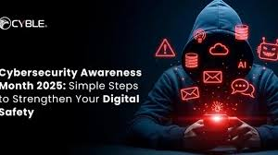
CYBER SECURITY
Cybersecurity is the practice of protecting systems, networks, programs, and data from digital attacks, unauthorized access, or damage. It involves people, processes, and technology to safeguard information confidentiality, integrity, and availability, reducing risks of data theft, financial loss, and operational disruptions.
Digital awareness in cybersecurity is the understanding and knowledge of potential cyber threats and the proactive strategies used to handle them. It involves recognizing risks—such as phishing, malware, and social engineering—and adopting responsible online behaviors to protect personal and organizational data.

Slide 3
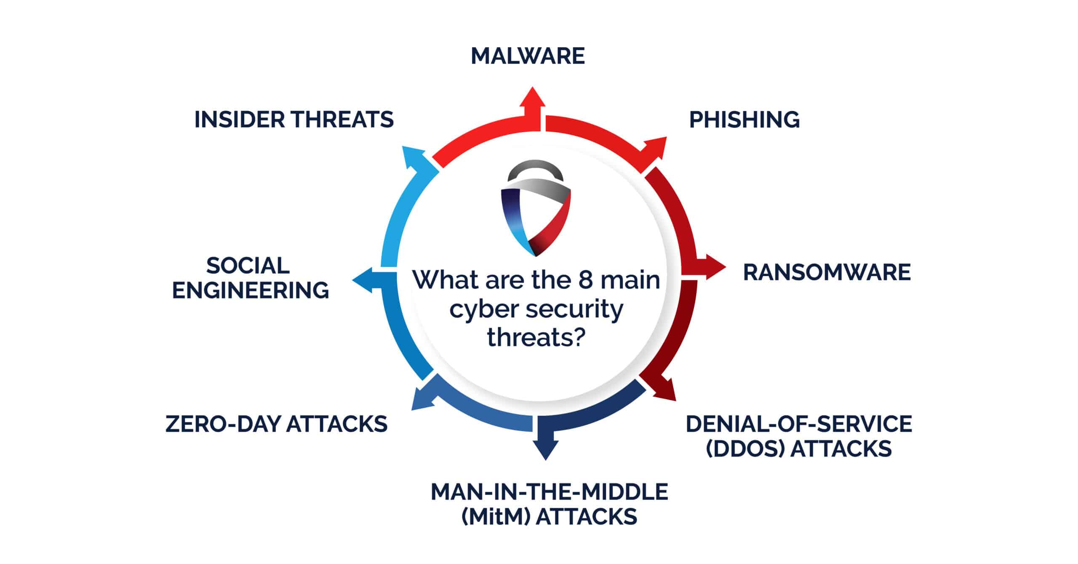
Cyber Thread
A cyber threat is any malicious attempt or potential risk that seeks to damage, disrupt, or gain unauthorized access to computer systems, networks, or data. These threats are typically carried out by individuals, groups, or organizations using digital means to exploit vulnerabilities in information systems.
Examples of Cyber Threats
Malware – Harmful software designed to damage or control systems
Phishing Attacks – Fake emails or messages used to trick users into revealing sensitive data
Ransomware – Locks your data and demands money to unlock it
Hacking – Unauthorized access to systems or accounts
Data Breaches – Exposure of confidential information

Slide 4
SAFETY RULES AND KNOWLEDGE
Safety Rules to Protect Yourself
1. Use Strong Passwords
Use a mix of letters, numbers, and symbols
Avoid simple passwords like “123456”
Change passwords regularly
Example: Instead of password123, use P@ssW0rd!89
2. Be Careful with Emails (Phishing)
Do not click on unknown links
Do not share OTP or personal info
Check sender email carefully
Example: Fake bank email asking for login details
3. Install Antivirus Software
Protects your system from malware and viruses
Keep it updated
4. Avoid Unknown Downloads
Do not download files from untrusted websites
Avoid cracked software and pirated content
5. Keep Software Updated
Update your phone, apps, and system regularly
Updates fix security problems
What You Should Know (Basic Knowledge)
Cyber threats are everywhere They can come through emails, websites, apps, or downloads.
Personal data is valuable Information like passwords, OTPs, bank details, and photos must be protected.
Hackers use tricks Most attacks happen because users trust fake links, emails, or messages.
Weak security = easy target Simple passwords and careless behavior increase risk.

Slide 5
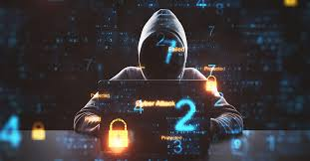
REAL LIFE ATTECS
WannaCry Ransomware (2017): A ransomware attack that encrypted files on over 200,000 computers across 150 countries, including hospitals within the UK's National Health Service (NHS).
Yahoo! Data Breaches (2013-2014): One of the largest breaches in history, where all 3 billion Yahoo accounts were compromised, leaking user names, passwords, and security questions.
Colonial Pipeline Ransomware (2021): Hackers (DarkSide) targeted the largest fuel pipeline in the US, forcing it to shut down for several days, causing fuel shortages and necessitating a ransom payment of over $4 million.
Stuxnet Worm (c. 2010): A sophisticated weaponized computer code designed to sabotage Iran's nuclear program by damaging centrifuges.
Sony Pictures Hack (2014): A group known as GOP (Guardians of Peace) leaked confidential emails and data from Sony Pictures, demanding the cancellation of a film.
Estonia DDoS Attacks (2007): Following political disputes, hackers launched massive Distributed Denial of Service (DDoS) attacks against Estonian government, banking, and media websites, disrupting public services.
SolarWinds Supply Chain Attack (2020): Russian hackers inserted malicious code into software updates for SolarWinds' Orion platform, compromising multiple US government agencies and private companies.
PowerSchool Data Breach (2025): Hackers utilized a stolen account lacking multi-factor authentication to steal data from over 62 million students and 9.5 million teachers in the US.

Slide 6
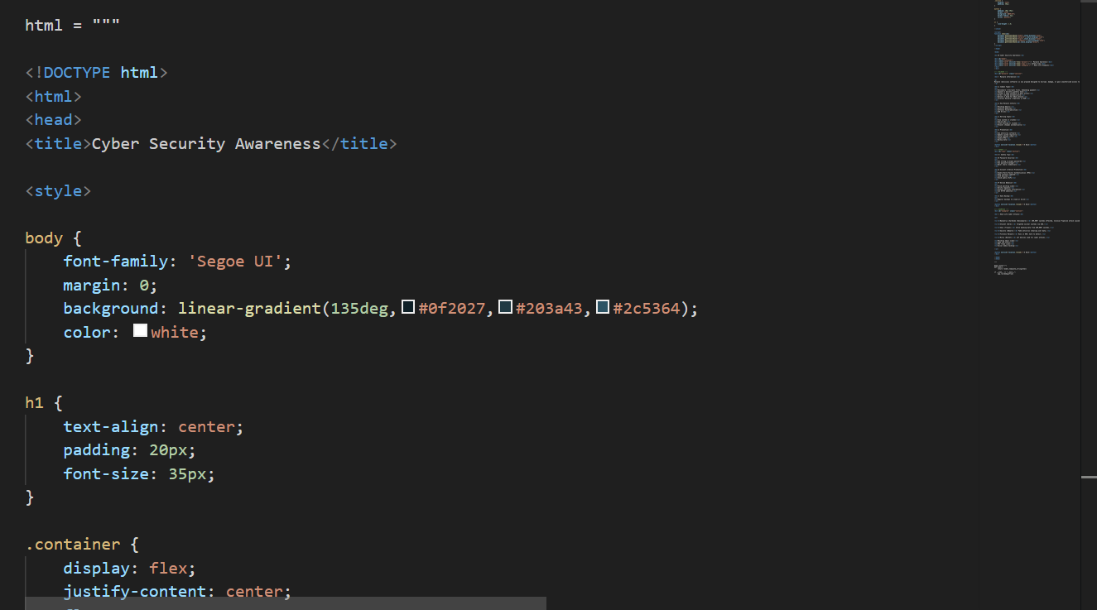
PROJECT- “DIGITAL AWARENESS” (CYBER SECURITY AWARENESS)
This project has been developed to raise awareness among people about cyber security in today’s digital world. With the increasing use of the internet, many users are unaware of cyber threats and become easy targets of cyber crimes. The main aim of this project is to educate users so that they can protect themselves from such threats.
In this project, we have included basic information about cyber security and various types of cyber threats, especially malware. It explains what malware is, how it affects systems, and how users can stay safe from such attacks. Along with this, the project also provides important safety tips that users should follow while using the internet.
To make the content more understandable and relatable, real-life examples of cyber crimes have also been added. These examples help users understand how cyber attacks happen in real situations and what mistakes should be avoided.
Overall, this project is designed to spread awareness and ensure that people become more cautious and informed while using digital platforms, so they can protect themselves from potential cyber risks and losses.

Slide 7
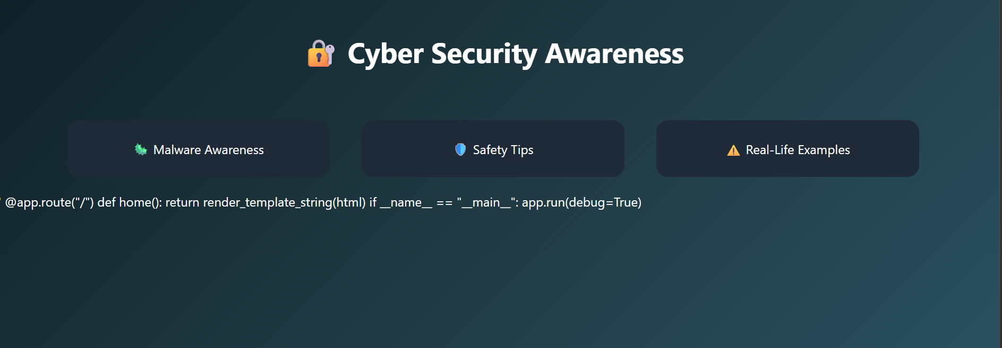
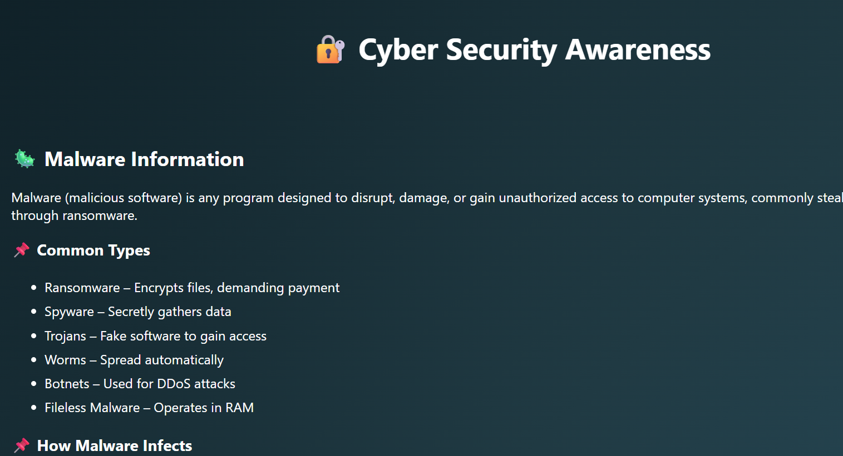
MALWARE
In this project, basic information about malware has been included to help users understand this common cyber threat. Malware, short for malicious software, refers to harmful programs designed to damage, disrupt, or gain unauthorized access to computer systems.
The project explains what malware is, how it works, and the different ways it can affect users, such as stealing personal data, slowing down devices, or corrupting files. It also highlights how malware can enter a system through unsafe downloads, unknown links, or infected websites.
By including this information, the project aims to make users aware of malware and help them take necessary precautions to stay safe while using the internet.

Slide 8
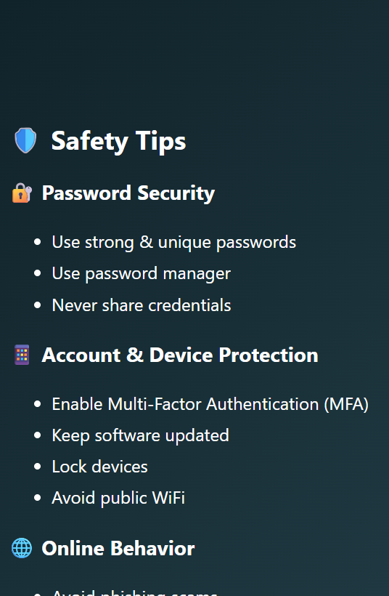
SAFETY RULES
In this project, various safety tips have been included to help users protect themselves from cyber threats. These tips are designed to guide people on safe online practices and reduce the risk of becoming victims of cyber crimes.
The project highlights important precautions such as creating strong passwords, avoiding suspicious links, not sharing OTPs or personal information, and regularly updating software and antivirus systems. It also emphasizes the importance of being cautious while using public Wi-Fi and downloading files from unknown sources.
By following these safety measures, users can significantly reduce the chances of cyber attacks and ensure a safer digital experience.

Slide 9
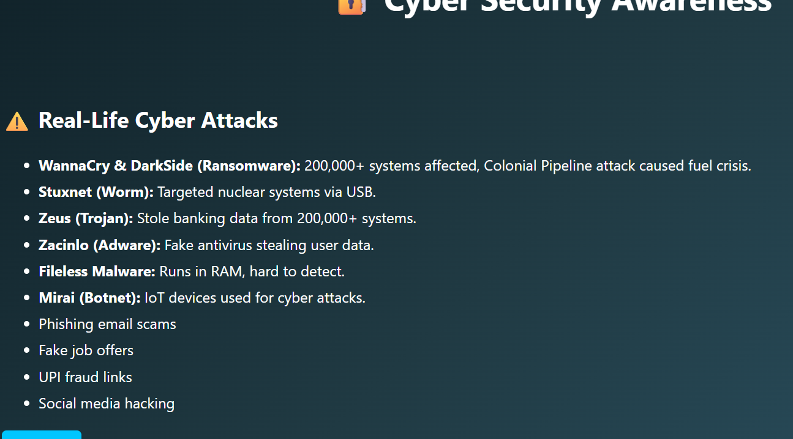
EXAMPLE
In this project, real-life examples of cyber crimes have also been included to make users more aware and informed. These examples help in understanding how cyber attacks actually occur in everyday situations and how easily people can become victims if they are not careful.
The project presents common scenarios such as phishing emails, fake links, OTP frauds, and social media account hacking. By showcasing these real-world cases, users can relate better and identify similar threats in their own digital activities.
Including real-life examples makes the project more practical and impactful, as it not only provides theoretical knowledge but also helps users recognize and avoid potential cyber risks in real situations.

Slide 10
SCREENSHORTS

Slide 11
PROJECT
This is a Digital Awareness (Cyber Security Awareness) project designed to educate users about various cyber threats and provide essential knowledge and safety measures to help them stay secure in the digital environment.
Link : https://github.com/pratimasahupratima4-ctrl/Digital-Awareness.git

Slide 12
THANK YOU

